Slide 1
Mobile Security Testing Guide
Presentation done by: Basel Alzyoud
Ac0342
DR. Nader Salameh

Slide 2
What is Mobile Security Testing Guide (MSTG)?
The MSTG is a comprehensive manual for mobile app security testing.
It is based on security testing and reverse engineering for iOS and Android mobile security testers.
This guide is all about setting standards for OS security testing It comes with many features:

Slide 3
1. Mobile platform internals
The OWASP mobile security application testing guide follows different security requirements that are outlined for the development and security testing of the mobile application.
The guide includes different procedures such as penetration testing and others to examine the potential security threats found in the app.

Slide 4
2. Security testing in the mobile app development lifecycle
Security testing is an important part of mobile app development.
It is done throughout the phase of the development of the app.
Black-box testing, White-box testing and Gray-box testing and conducted to explore all the possible information and exploit vulnerabilities.

Slide 5
3. Basic static and dynamic security testing
Static application security testing (SAST) is a testing procedure that checks the mobile application from the inside out.
Whereas Dynamic application security testing (DAST) checks the mobile application from the outside, examining its current running state and discovering security threats.

Slide 6
4. Mobile app reverse engineering and tampering
Reverse engineering a mobile application is the procedure that follows the analysis of the compiled app for extracting information regarding its source code.
Tampering follows the procedure of changing a mobile application or its environment to alter its behavioral patterns.

Slide 7
5. Assessing software protection
Software protection assessments are used to avoid malicious activities taking place on the software.
This assessment includes routines for evaluating requirements for documentation and risk assessment, leading to data protection

Slide 8
6. Detailed test cases that map to the requirements in the MASVS
You cannot compromise with mobile data safety!
Get comprehensive test cases in compliance with the Mobile AppSec Verification Standard in the OWASP Mobile Security Testing Guide.

Slide 9
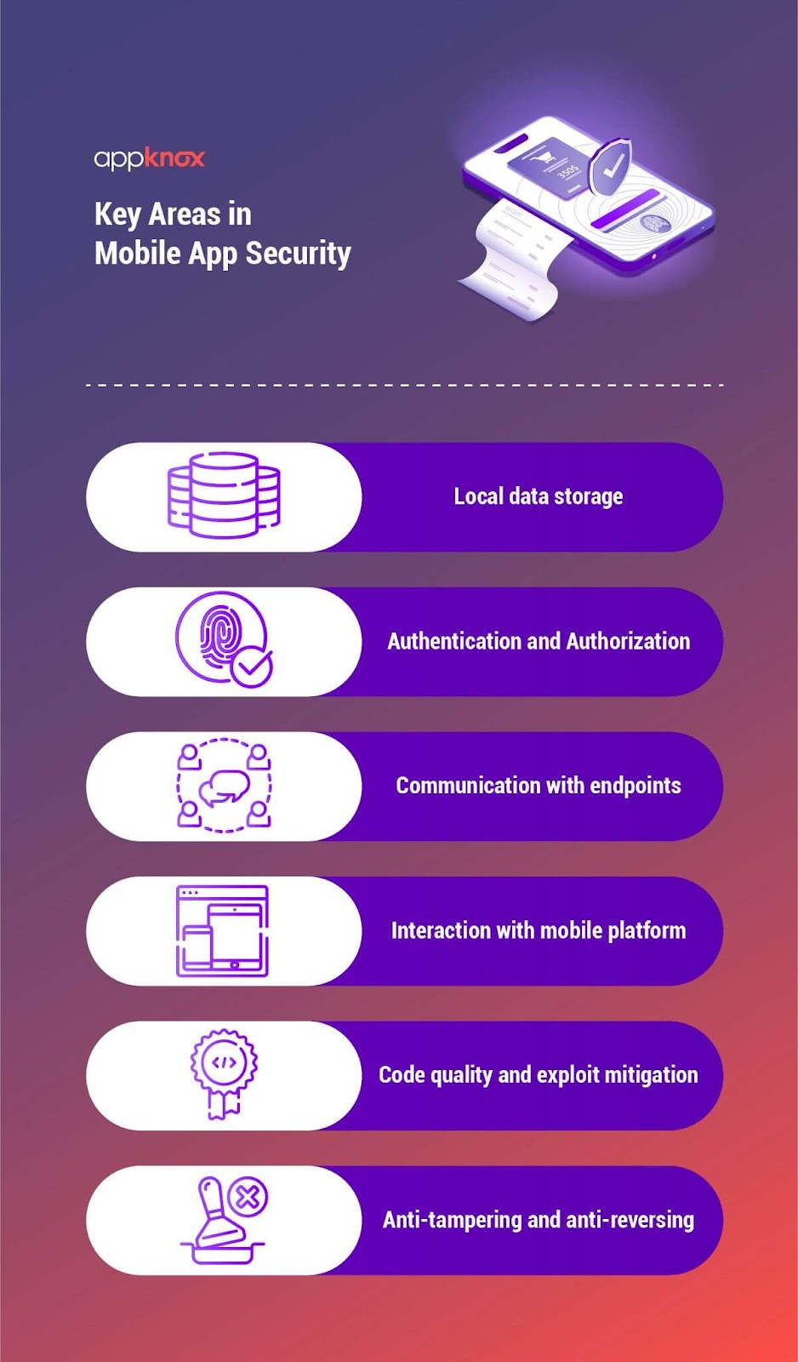

Slide 10
Key Areas in Mobile App Security
Mobile apps differ from web apps in that they have a smaller attack surface and hence higher protection against cyber threats.
To improve mobile app security, we must prioritize data protection on the mobile and the network.
Given below are the key areas in mobile app security.

Slide 11
1. Local data storage
When creating mobile apps, you must exercise extreme caution when storing user data.
If an app inappropriately exploits operating system APIs like local storage, it may expose sensitive data to other apps running on the same device.

Slide 12
2. Authentication and Authorization
The endpoint handles the majority of the authentication and authorization logic.
Unlike web apps, the users unlock mobile apps using user-to-device authentication capabilities like fingerprint scanning, instead of entering complex passcodes.
Security testers must keep in mind the benefits and drawbacks of various authorization systems.

Slide 13
3. Communication with endpoints
Mobile devices provide the door to a wide range of network-based assaults, from simple to complex.
Therefore, apps must use the TLS protocol to establish a secure, encrypted channel for network connection.
Maintaining the integrity of information sent between the mobile app and distant service endpoints is critical.

Slide 14
4. Interaction with mobile platform
Mobile operating systems have greater inter-process communication tools (IPC tools), allowing apps to exchange signals and data.
These platform-specific capabilities have their own set of drawbacks.
If IPC APIs are utilized incorrectly, confidential data may be inadvertently exposed.

Slide 15
5. Code quality and exploit mitigation
Because of the smaller attack surface, mobile apps have a lesser attack surface than online apps.
Cross-site scripting is potentially conceivable in some instances on mobile.
Therefore, you must follow practices for security, creating secure release builds.

Slide 16
6. Anti-tampering and anti-reversing
Because software protection features are frequently utilized in the mobile app market, security testers must learn how to get around them.
Client-side protections have a benefit, provided you implement them with reasonable expectations in mind and are not utilized to substitute security controls.
MSTP will guide you in focusing on these key areas.

Slide 17
Mobile App Taxonomy
Any software that runs on a mobile device is referred to as a "mobile app." The following are some examples of mobile apps:

Slide 18
1. Native application
A native app is a software program, developed for usage on a particular platform or device i.e. iOS or Android.
It is built in a specific programming language.
While the native iOS apps are written in Objective-C or Swift, whereas the native Android apps are worked around with Java.
These apps provide a high degree of reliability and quick performance.

Slide 19
2. Web application
In contrast to computer-based software applications that run locally on the device's operating system, a web application is application software that runs on a web server.
A web browser with an active network connection is used by the user to access web applications.

Slide 20
3. Hybrid application
A hybrid app is software that includes characteristics of both native and online apps.
The problem with hybrid applications is that their pace is dependent on the browser's speed; hence, hybrid mobile apps are typically slower than native apps.

Slide 21
4. Progressive Web application
A progressive web application (PWA) is a sort of web-based application software constructed with common web technologies such as HTML, CSS, and JavaScript.
The design of these apps will help them to run on any platform that supports standards-compliant browsers, including desktop and mobile devices.

Slide 22
General Mobile App Security Principles
One must perform mobile application security testing all through the development process till the application is released.
Various types of testing are carried out, and given below are some of them.

Slide 23
1. Black-box testing
Black Box Testing is a software testing technique that tests the functionality of application software without knowing the internal code structure, operational characteristics, or internal routes.
It is also referred to as Behavioral Testing or Zero-Knowledge Testing.

Slide 24
2. White-box testing
White Box Testing is a software testing method in which the underlying structure, layout, and code of the software are examined to ensure that the input-output flow is correct and to improve design, usability, and security.
It is also known as clear box testing or Full Knowledge Testing.

Slide 25
3. Gray box testing
Grey box testing is a software testing approach used to test a software product or application with just a limited understanding of the application's internal structure.
The goal of gray box testing is to look for and detect faults caused by poor code structure or application use.

Slide 26
4. Vulnerability testing
Vulnerability testing or vulnerability assessment is the practice of assessing security risks in software systems to reduce the likelihood of threats.
The goal of vulnerability testing is to reduce the likelihood of hackers gaining unauthorized access to systems.
It includes scanning of networks, systems, and other parts of the ecosystem. Network and wireless assessment, host assessment, database assessment, and applications scans are a few types of vulnerability assessments.

Slide 27
5. Penetration testing
A penetration test, often known as a pen test, is an attempt to evaluate the security of software by exploiting its weaknesses in a safe manner.
Human-based penetration testing is a manual process that is executed by human beings having special skill sets.
While different tools are used in this process, human ingenuity is applied to exploit vulnerabilities and test for any attack. You will get all the necessary details of these testing methods in the OWASP Mobile Security Testing Guide.

Slide 28
Best Practices for Mobile App Security
Information is power. With such sensitive information at stake, mobile app developers must do everything possible to protect their users.
Here are some ideas for how developers might include security into their apps:

Slide 29
Best Practices for Mobile App Security
Keep your code's security in mind at all times and strengthen it to make it difficult to break.
You must encrypt every piece of data transferred via your app.
Follow the idea of the least privilege that states that a program should be run with just the minimum required permissions.
It is critical to stay up to pace on the latest security algorithms and to adopt modern encryption methods whenever possible.
Many mobile applications use a client-server approach.
It is critical to have security measures in place to protect backend systems against malicious attacks.

Slide 30
Strategy for Security Testing
Security testing, like functionality and requirement testing, necessitates an in-depth understanding of the app as well as a well-defined plan for carrying out the actual testing.
Given below are a few strategies for security testing, which you will get in detail in the OWASP Mobile Security Testing Guide.

Slide 31
1. Nature of the app
You have to decide how much security testing is necessary based on the type and purpose of your app.
For instance, if it deals with financial transactions, you have to check payment gateways and add a multi-factor or a two-factor authentication.
To add an extra layer of security, fingerprint or password login needs to be authorized.

Slide 32
2. Time required for testing
You must evaluate how much time you can commit to security testing based on the total time allotted for testing.

Slide 33
3. Efforts needed for testing
Security testing is more difficult than other sorts of testing because there are few project rules for it.
Therefore, you and your team must define and agree with the testing requirements.

Slide 34
4. Knowledge transfer
You might need extra time studying the code or tools to comprehend the app's security and related testing.
Devote extra time for this knowledge transfer before making a final testing strategy.

